Slide 1
Monitoring Heart Health:
Using Machine Learning to understand potential risks for death caused by heart failure.
Norris Jaber
Rajeev Agrawal
Jen-Yu Huang
Yuxi Duan
Sha Lu

Slide 2
Agenda
Business Case and Question
Analytics Question
The Data
Descriptive Analytics
Model Selection and Specifications
Results
Conclusion

Slide 3
Business Case and Question
The Question: What factors increase the risk of death due to heart failure?
Cardiovascular Diseases are the number one cause of death worldwide.
17.9 million deaths per year, 31% deaths globally
Provide healthcare providers with greater insight in biological signs to mitigate risk.
Potentially reduce death by heart failure

Slide 4
Analytics Question
Interpretation
What biological variables are most influential on death by heart failure?
Prediction
Which patients specifically are at most risk?

Slide 5

The Data
Kaggle (Apr - Dec 2015)
299 Patients
194 Male, 105 Female
Ventricular Systolic Dysfunction
Previous heart failures

Slide 6
Descriptive Analytics
Variables
Outcome: DEATH_EVENT
Cat: Anemia, High blood pressure, Diabetes, Sex, Smoking
Qnt: *Age, *Ejection Fraction, *Serum Creatinine, *Time, Platelets, Creatinine Phosphokinase and Serum Sodium
Age: Age of the patient in years
Ejection Fraction: Percentage of blood leaving the heart at each contraction
Serum Creatinine: Level of creatinine in the blood in mg/dL
Time: Follow-up period in days

Slide 7
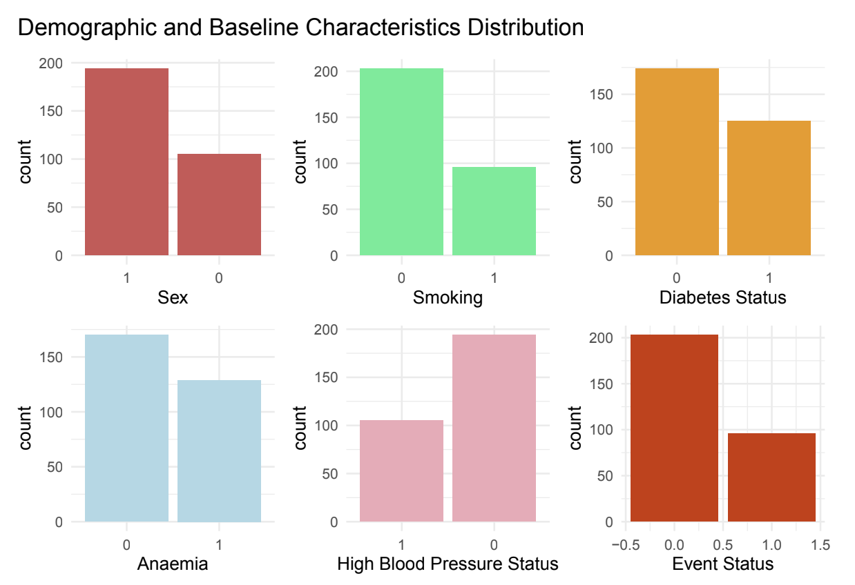
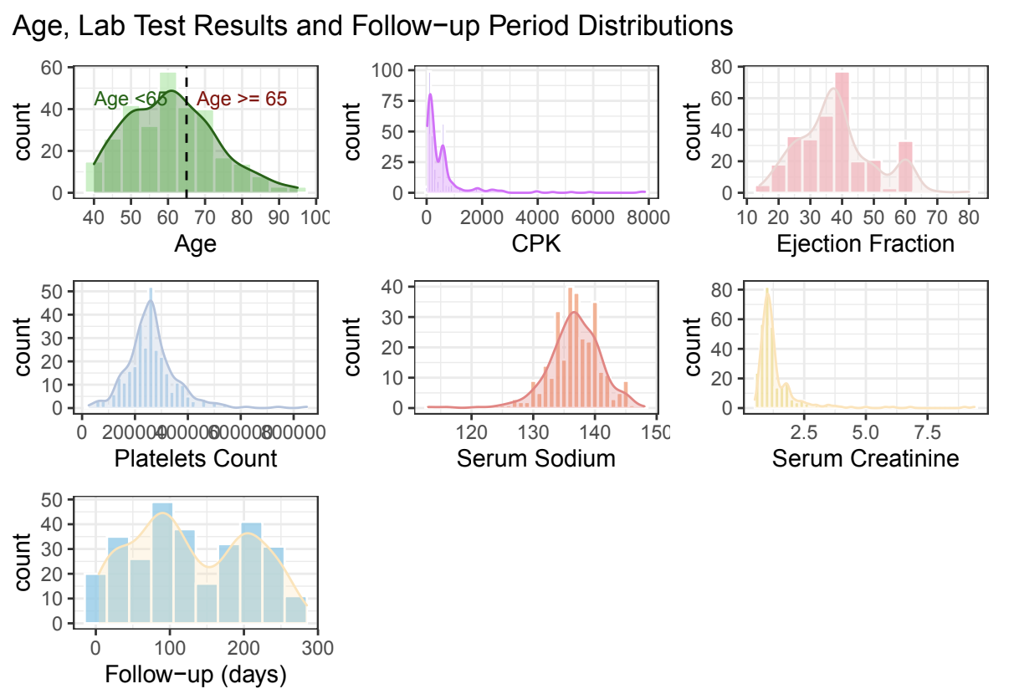
Descriptive Analytics

Slide 8
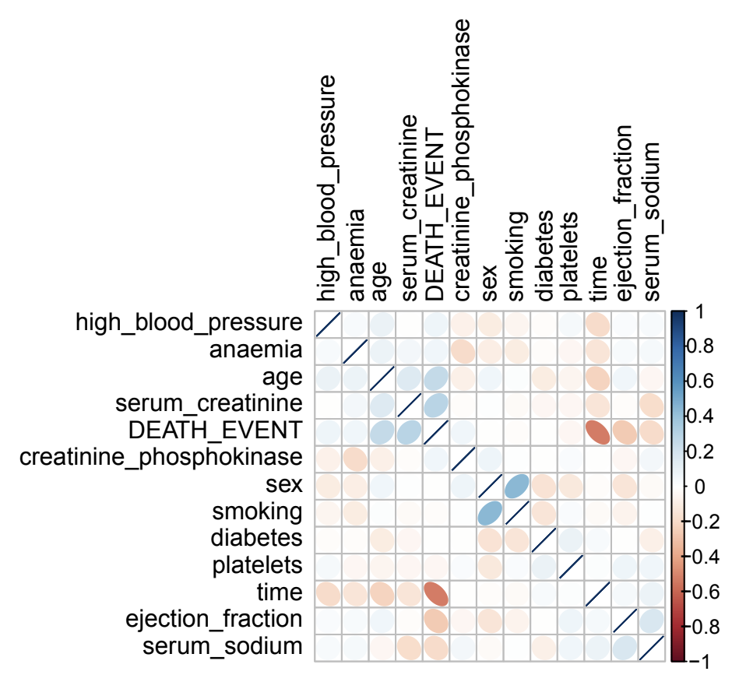
Descriptive Analytics
Point-Biserial
Correlation Map

Slide 9
Model Selection and Model Specification
1. Logistic Model
Multicollinearity (full model)
2. LASSO Model
Enhancing predictive power
3. Random Forest
4. Boosted Trees

Slide 10
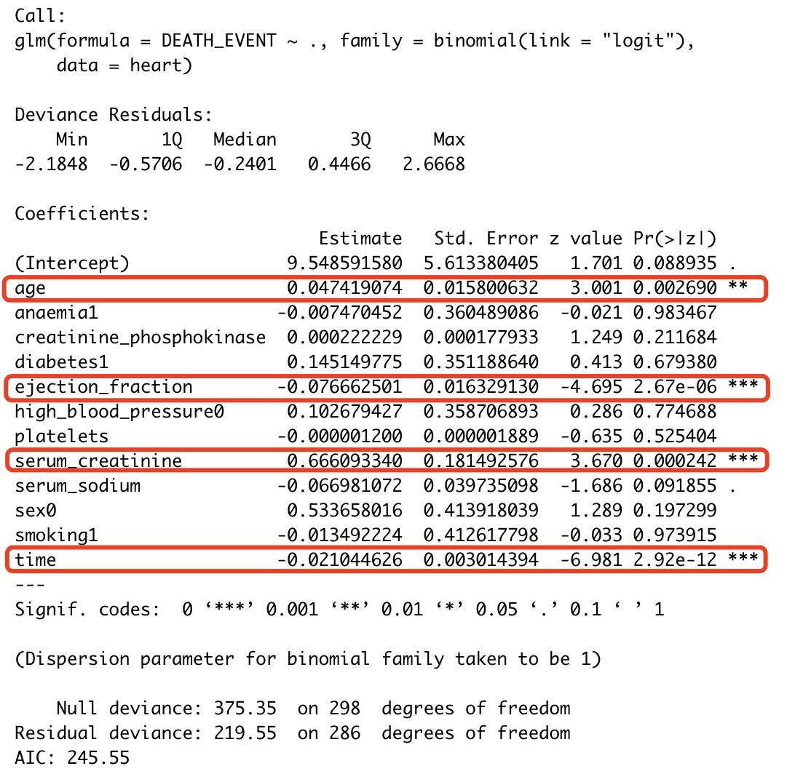
Model Selection and Model Specification
1. Full Model:
With all the variables.
2. Model Specification:
Only included four significant variables.

Slide 11
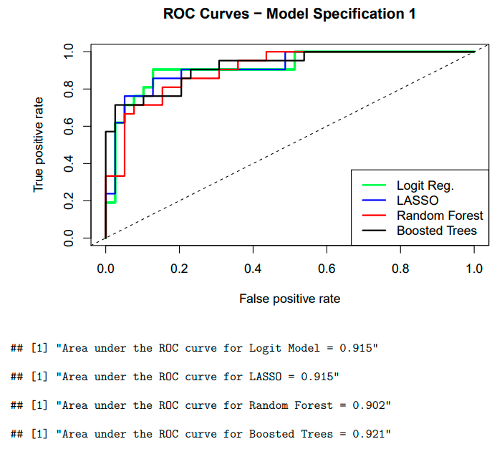
Results
Model selection:
Interpretability – Logistic Regression
with only significant
predictors
Predictability – Full boosted tree with the
largest AUC value

Slide 12
Results
Logistic regression:
Positive : Age and serum creatinine
For each year increase in age, the log odds of dying from heart failure increases by 0.04, that is when all variables are held in constant.
As with serum creatinine, on average and when holding all variables constant, when serum creatinine increased by 1 milligram per deciLiter, the log odds of death by heart failure increased by 0.72.
Negative: Ejection fraction and time
When holding all variables constant, on average per 1% increase in ejection fraction, the log odds of death by heart failure decreased by 0.07.
As for time, when holding all variables in constant, when time between doctor visits increased by 1 day, the log odds of death by heart failure decreased by 0.02.
Boosted tree:
Conjunction with the logistic model to better explain how each of these significant variables plays a role in their heart health.

Slide 13
Conclusion
Interpretation:
Logistic model with the 4 significant predictors - age, serum creatinine, ejection fraction, and time.
Knowing how these predictors influence the outcome will allow healthcare providers to provide better care and allow them to mitigate the risks for their patients and hopefully result in less death from heart failure.
Prediction:
Full boosted tree has the best overall performance.
Will allow healthcare providers to make predictions for a specific patient using the patient data.

Slide 14
Limitations
Data sourced from a very specific location. Further research needed to check if similar results are seen for data from a different geographical region.
Small dataset (299 patients): a larger dataset would have permitted us to obtain more reliable results.
Additional information about the physical features of the patients (height, weight, BMI, etc.) and their occupational history would have been useful to detect additional risk factors for cardiovascular health diseases.

Slide 15

Questions?
Link to GitHub
Contains Data set and R Markdown File w

